Slide 1




Hallucination or Creativity:
How to Evaluate AI-Generated Scientific Stories?
Alex Argese, Pasquale Lisena, Raphaël Troncy
Text2Story @ ECIR 2026
Delft, 29 March 2026

Slide 2
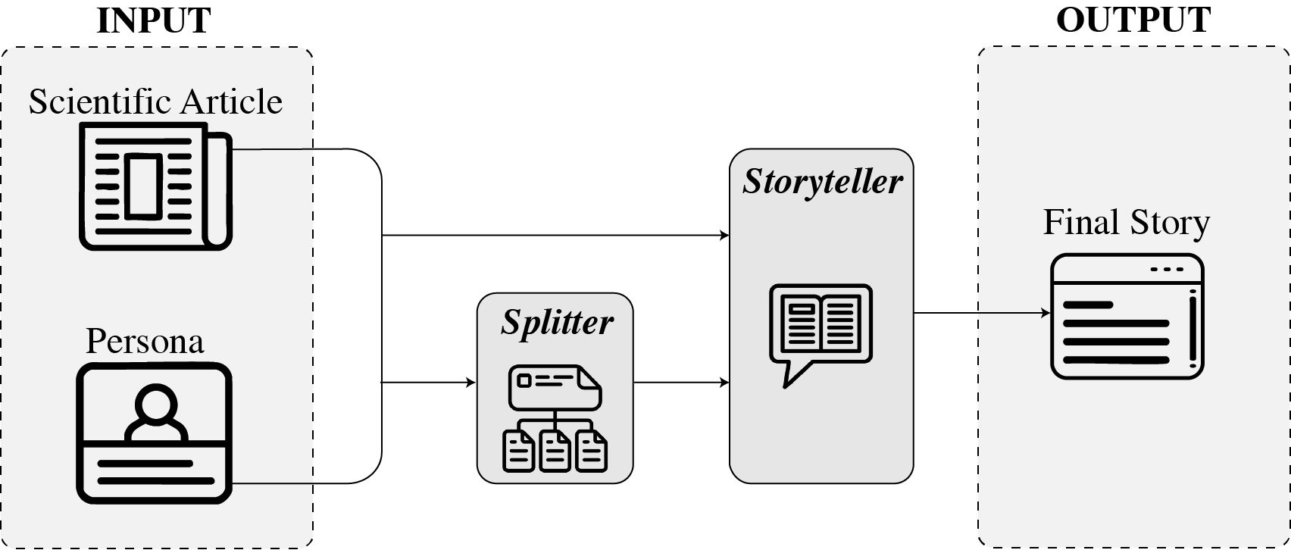
AI Scientist Storyteller
Turn scientific papers into stories
Adapt to different personas:
Researchers & Engineers
Student
Teacher
Policy Maker
Jounalist
Investor
General pulic
https://sciteller.tools.eurecom.fr/
Alex Argese, Pasquale Lisena, Raphaël Troncy
Text2Story @ ECIR 2026
Delft, 29 March 2026

Slide 3
Why evaluating scientific stories is challenging?
A good scientific story must preserve the paper’s meaning while adapting structure and tone to a target audience.
Traditional metrics alone (ROUGE, BERTScore, etc.) are not enough
We want stories that are factual accurate, but have freedom in structure, for engagement and creativity
Example
Paper
“Attention Is All You Need” Vaswani et al., 2017
Factual Summary
The paper introduces the Transformer, a model based on attention mechanisms, removing recurrence and convolution.
Story for General Public
Imagine a reader that doesn’t follow words one by one, but looks at the whole sentence at once, focusing on what matters most. That’s the idea behind the Transformer.
Alex Argese, Pasquale Lisena, Raphaël Troncy
Text2Story @ ECIR 2026
Delft, 29 March 2026

Slide 4
Our Contribution
A new metric for AI-generated scientific stories: the StoryScore metric
A comparison of different hallucination detectors for AI-generated scientific stories
Alex Argese, Pasquale Lisena, Raphaël Troncy
Text2Story @ ECIR 2026
Delft, 29 March 2026

Slide 5

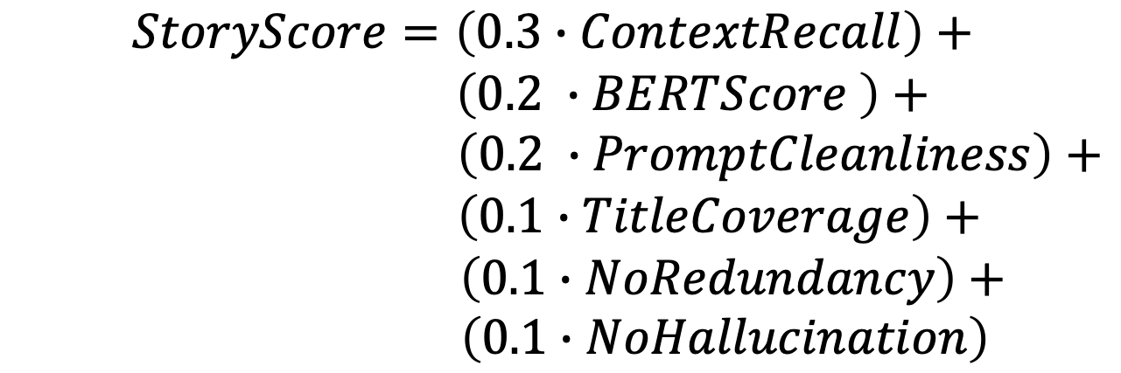
StoryScore
Context Recall
Measures vocabulary overlap between paper and story
$Jaccard recall = \frac{|tokens_story ∩ tokens_paper|}{|tokens_paper| }$
→ i.e.: how much of the paper's vocabulary is reused in the story.
Scale: 0–1
High value = large lexical coverage of the paper
Composite evaluation metric
$$StoryScore=\left(0.3∙ContextRecall\right)+$$
$$\left(0.2 ∙BERTScore \right)+$$
$\left(0.2 ∙PromptCleanliness\right)+$
$\left(0.1∙TitleCoverage\right)+$
$\left(0.1∙NoRedundancy\right)+$
$\left(0.1∙NoHallucination\right)$
Alex Argese, Pasquale Lisena, Raphaël Troncy
Text2Story @ ECIR 2026
Delft, 29 March 2026

Slide 6
StoryScore
BERTScore
(semantic similarity)
Measures semantic alignment with the source paper
BERTScore between concatenated story sections and paper context
Model: roberta-large
Scale: 0–1
High value = story semantically close to the paper
Composite evaluation metric
$$StoryScore=\left(0.3∙ContextRecall\right)+$$
$$\left(0.2 ∙BERTScore \right)+$$
$\left(0.2 ∙PromptCleanliness\right)+$
$\left(0.1∙TitleCoverage\right)+$
$\left(0.1∙NoRedundancy\right)+$
$\left(0.1∙NoHallucination\right)$
Alex Argese, Pasquale Lisena, Raphaël Troncy
Text2Story @ ECIR 2026
Delft, 29 March 2026

Slide 7
StoryScore
Prompt Cleanliness
(Prompt Leakage Control)
Verifies absence of prompt or control artefacts in the output
Flags residual instructions, schema markers, or malformed structure
Scale: 0–1
High value = correct constraint following
Composite evaluation metric
$$StoryScore=\left(0.3∙ContextRecall\right)+$$
$$\left(0.2 ∙BERTScore \right)+$$
$\left(0.2 ∙PromptCleanliness\right)+$
$\left(0.1∙TitleCoverage\right)+$
$\left(0.1∙NoRedundancy\right)+$
$\left(0.1∙NoHallucination\right)$
Alex Argese, Pasquale Lisena, Raphaël Troncy
Text2Story @ ECIR 2026
Delft, 29 March 2026

Slide 8
StoryScore
Title Coverage
(structural consistency)
Comparison after normalisation of the Storyteller titles and Splitter titles.
Necessary to check the consistency of the structure
Binary scale: 0 or1
Score = 1 if all 5 match exactly → 0 otherwise
Composite evaluation metric
$$StoryScore=\left(0.3∙ContextRecall\right)+$$
$$\left(0.2 ∙BERTScore \right)+$$
$\left(0.2 ∙PromptCleanliness\right)+$
$\left(0.1∙TitleCoverage\right)+$
$\left(0.1∙NoRedundancy\right)+$
$\left(0.1∙NoHallucination\right)$
Alex Argese, Pasquale Lisena, Raphaël Troncy
Text2Story @ ECIR 2026
Delft, 29 March 2026

Slide 9

StoryScore
No Redundancy
(fluency and avoidance of loops)
Tokenisation of the story text
Generation of all 3-grams.
Calculation of the frequency of the most common.
$Repetition_{rate}= \frac{freq_{max}}{total_{3grams}}$
$NoRepetition= 1 – repetition_{rate}$
Scale: 0–1
High value = fewer repeated phrases or words
Composite evaluation metric
$$StoryScore=\left(0.3∙ContextRecall\right)+$$
$$\left(0.2 ∙BERTScore \right)+$$
$\left(0.2 ∙PromptCleanliness\right)+$
$\left(0.1∙TitleCoverage\right)+$
$\left(0.1∙NoRedundancy\right)+$
$\left(0.1∙NoHallucination\right)$
Alex Argese, Pasquale Lisena, Raphaël Troncy
Text2Story @ ECIR 2026
Delft, 29 March 2026

Slide 10

StoryScore
No Hallucination
(no invented entities)
Extraction of candidate entities (Named Entities wih Spacy «PERS» and «ORG») from the paper and the story.
$Hallucination_{rate}=\frac{\left(\begin{aligned}\#\#\#\#\#\#n. entities in the story \\ NOT present in the paper\end{aligned}\right)}{\left(n. entities in the story\right)}$
$NoHallucination = 1 – hallucination_{rate}$
Scale: 0–1
High value = almost no fictional entities
Composite evaluation metric
$$StoryScore=\left(0.3∙ContextRecall\right)+$$
$$\left(0.2 ∙BERTScore \right)+$$
$\left(0.2 ∙PromptCleanliness\right)+$
$\left(0.1∙TitleCoverage\right)+$
$\left(0.1∙NoRedundancy\right)+$
$\left(0.1∙NoHallucination\right)$
Alex Argese, Pasquale Lisena, Raphaël Troncy
Text2Story @ ECIR 2026
Delft, 29 March 2026

Slide 11
Our Contribution
A new metric for AI-generated scientific stories: the StoryScore metric
A comparison of different hallucination detectors for AI-generated scientific stories
Alex Argese, Pasquale Lisena, Raphaël Troncy
Text2Story @ ECIR 2026
Delft, 29 March 2026

Slide 12
Hallucination Detection in Scientific Storytelling
Why it matters?
A scientific story must remain faithful to the paper
Invented entities, wrong names, or unsupported claims reduce trust
Hallucination detection is therefore a key evaluation dimension
Why it is hard in a creative setting?
Stories may use metaphors and analogies
Stories may simplify terms for non-expert audiences
Not every wording difference is a hallucination
Alex Argese, Pasquale Lisena, Raphaël Troncy
Text2Story @ ECIR 2026
Delft, 29 March 2026

Slide 13
Hallucination Detection in Scientific Storytelling
Example A - acceptable creative reformulation
Paper
“The model transfers information between modules.»
Story
“It acts like a messenger passing information forward.”
Not a hallucination
metaphor, but meaning remains supported
Example B - real hallucination
Paper
Anonymized affiliation
Story
“The method was developed at the University of Birmingham.”
Hallucination
invented factual entity
Alex Argese, Pasquale Lisena, Raphaël Troncy
Text2Story @ ECIR 2026
Delft, 29 March 2026

Slide 14

Hallucination detection Methods Considered
NER-based
Candidate entities extraction (words with capitalised initial letters) from the paper and the story.
$Hallucination_{rate}=\frac{\left(\begin{aligned}\#\#\#\#\#\#n. entities in the story \\ NOT present in the paper\end{aligned}\right)}{\left(n. entities in the story\right)}, NoHallucination = 1 – hallucination_{rate}$
Evaluation examples
“University of Birmingham” → not in paper → correctly detected
story uses “AI”, paper uses “Artificial Intelligence” → incorrectly flagged
MIRAGE*
MIRAGE re-generates multiple rewrites of the story
Computes alignment between the original generation and its own rewrites
If a concept is unstable or unsupported, the model assigns high hallucination probability
Evaluation examples
to explain what is Robustness in AI, the story used a simpler example about object detection in images → MIRAGE considers the metaphor as a hallucination
* https://github.com/bVendeville/MIRAGE
Alex Argese, Pasquale Lisena, Raphaël Troncy
Text2Story @ ECIR 2026
Delft, 29 March 2026

Slide 15
Hallucination detection Methods Considered
LLM-as-a-judge (Qwen 7B & GPT 5.1)
A Large model (Qwen-7B) receives:
CONTEXT: the paper text
ANSWER: the story section
Generates a JSON containing:
name_accuracy
numeric_accuracy
overall_faithfulness
hallucinated_names / numbers
Evaluation examples
"Robust-kit, developed at the University of Birmingham…» → hallucination NOT detected
Correct story (human checked) LLM-as-judge incorrectly outputs hallucinated names: ["SwinUnetR", "MedSAM", "SAM-Med2D"] these appear in the paper but not in that section → incorrect flagged
Alex Argese, Pasquale Lisena, Raphaël Troncy
Text2Story @ ECIR 2026
Delft, 29 March 2026

Slide 16
Hallucination detection Methods Considered
Hybrid Hallucination Detection (HHD)
Step 1 — Entity extraction with SpaCy
Identify “technical tokens”: Capitalised words, acronyms, numbers…
Ignore metaphorical or generic words → no false positives
Step 2 — Semantic support check For each sentence:
Find top-k most similar paper sentences (MiniLM embeddings)
Check if each technical token appears in those contexts
Step 3 — Hallucination rule A token is hallucinated only if:
It does NOT appear in any top-k similar paper sentences
AND the similarity < 0.6
Evaluation examples
Hermes, the messenger god of ancient Greece, was known for his speed and efficiency. Similarly, the HERMES system acts as a swift messenger between the initial prompt and the final, refined medical image segmentation.
The proposed solution, is an automated framework designed to enhance the accuracy of flash memory (FM)-based segmentation.
→ it is a consistent creative simile. Incorrect detection.
→ In the paper, FM stands for Foundation Model, not Flash Memory. Incorrect detection.
Alex Argese, Pasquale Lisena, Raphaël Troncy
Text2Story @ ECIR 2026
Delft, 29 March 2026

Slide 17
Hallucination detection Methods Considered
Need a metric for detecting hallucinations in creative storytelling tasks in the world of scientific research.
↓
Kept the simplest and most effective detector (NER) with SpaCy
METHOD | Capitalised Words | SpaCy NER | MIRAGE | LLM-Judge (Qwen 7B) | LLM-Judge (GPT 5.1) | HHD (hybrid)
WHAT IT DETECTS | Surface-form mismatch | Incorrect PERSON/ORG entities | Rewrite-consistency instability | Factual consistency | High-level reasoning errors | Entity + retrieval alignment
KEY WEAKNESS | Flags abbreviations & creative capitalisations as errors | Misses conceptual errors (wrong claims, invented datasets) | Penalises analogies and audience-adapted rephrasing | "Hallucinates hallucination" labels correct facts as errors | Overcautious: flags benign contextual expansions | Dominant false positives; threshold unstable
VERDICT | Too noisy | ✓ Chosen | Too rigid | Unstable | Too strict | Unreliable
Alex Argese, Pasquale Lisena, Raphaël Troncy
Text2Story @ ECIR 2026
Delft, 29 March 2026

Slide 18
Preliminary Evaluation on a story set
76 generated stories (Pre-trained vs Fine-tuned pipeline)
Fine-tuning strongly improves overall StoryScore
The biggest gain is Prompt Cleanliness: prompt leakage is essentially removed
Better human readability confirmed by StoryScore: 0.560 → 0.787
Alex Argese, Pasquale Lisena, Raphaël Troncy
Text2Story @ ECIR 2026
Delft, 29 March 2026

Slide 19
Conclusion and Future Works
These metrics provide approximations rather than ground-truth guarantees
Improve grounding mechanisms and hallucination mitigation
Scale up evaluation with larger and more diverse evaluator
Alex Argese, Pasquale Lisena, Raphaël Troncy
Text2Story @ ECIR 2026
Delft, 29 March 2026

Slide 20

Thank you for your attention
Repository bit.ly/ai-sci-storyteller
Mail alex.argese@eurecom.fr
Alex Argese, Pasquale Lisena, Raphaël Troncy
Text2Story @ ECIR 2026
Delft, 29 March 2026
20

